Slide 1

Requirements

Slide 2
Download Requirements
Download Python:
https://www.python.org/downloads/
Download Visual Studio Code:
https://code.visualstudio.com/

Slide 3
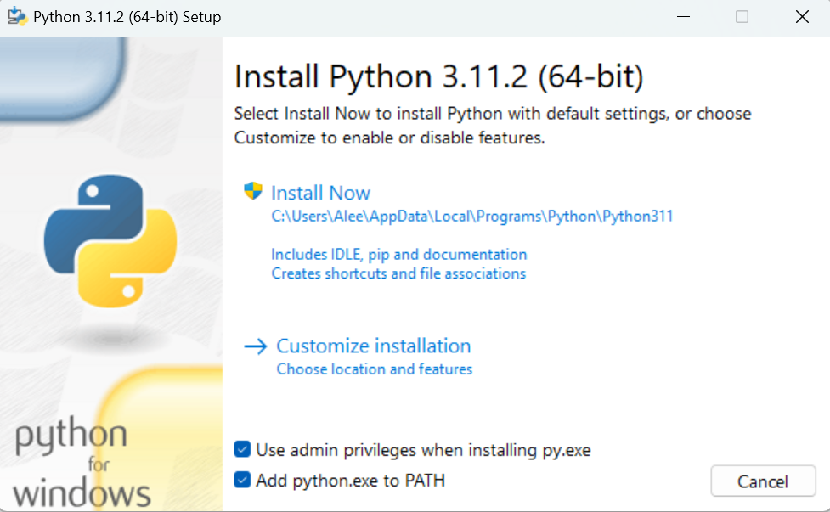
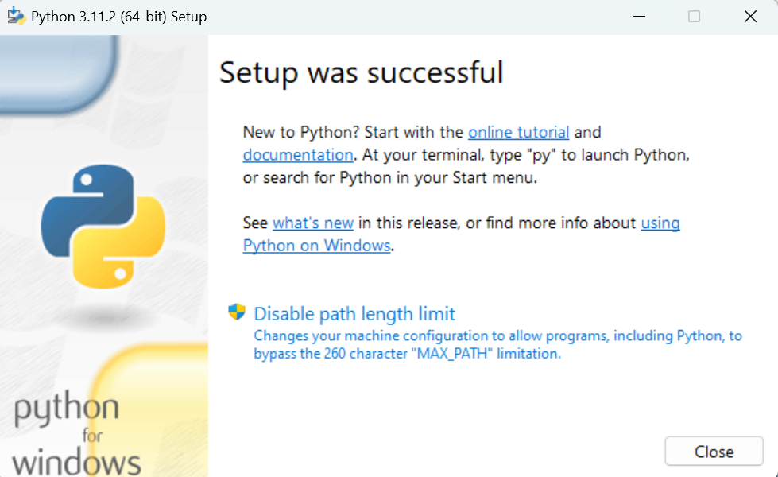
Install Python

Slide 4
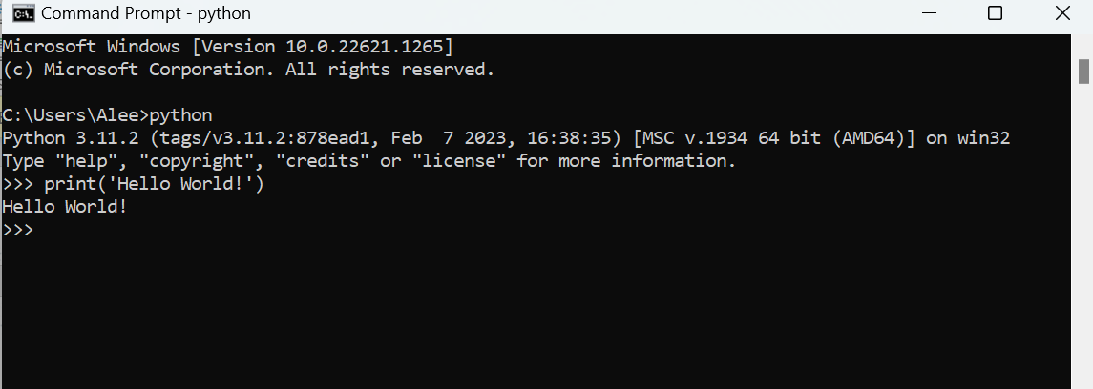
Open Python

Slide 5
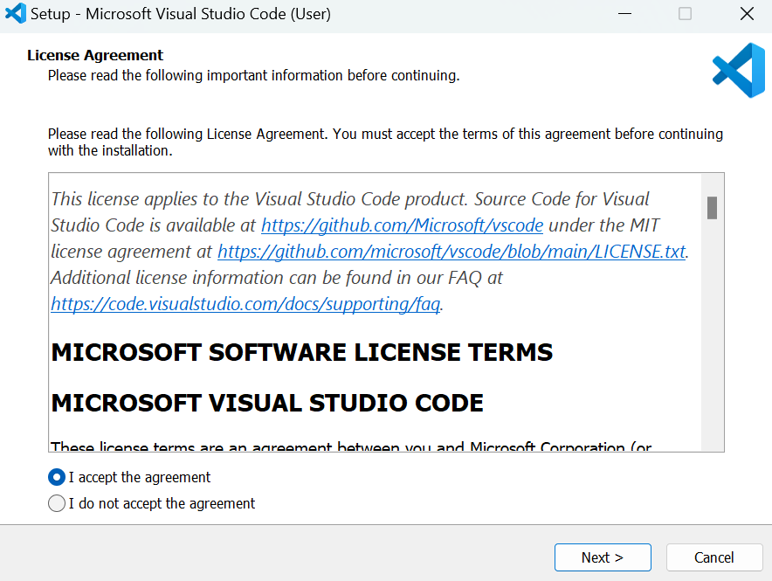
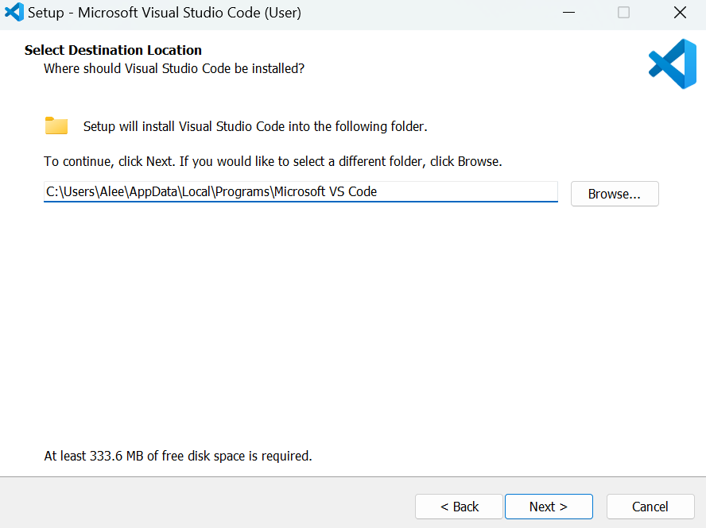
Install VS Code

Slide 6
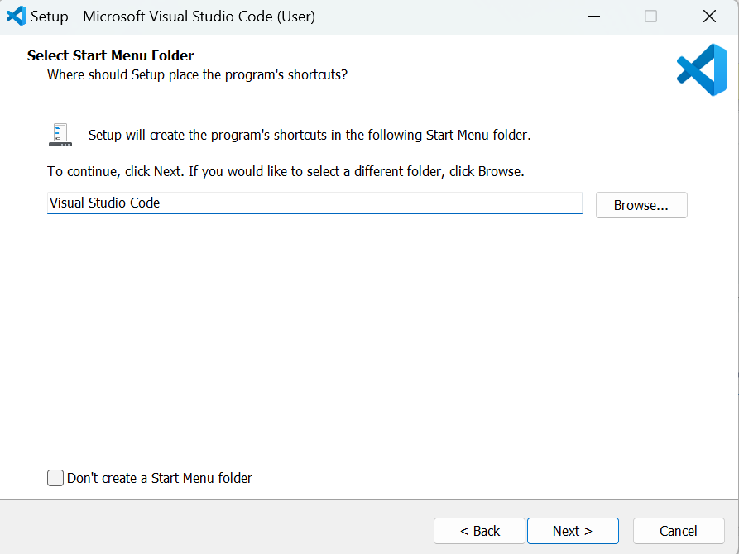
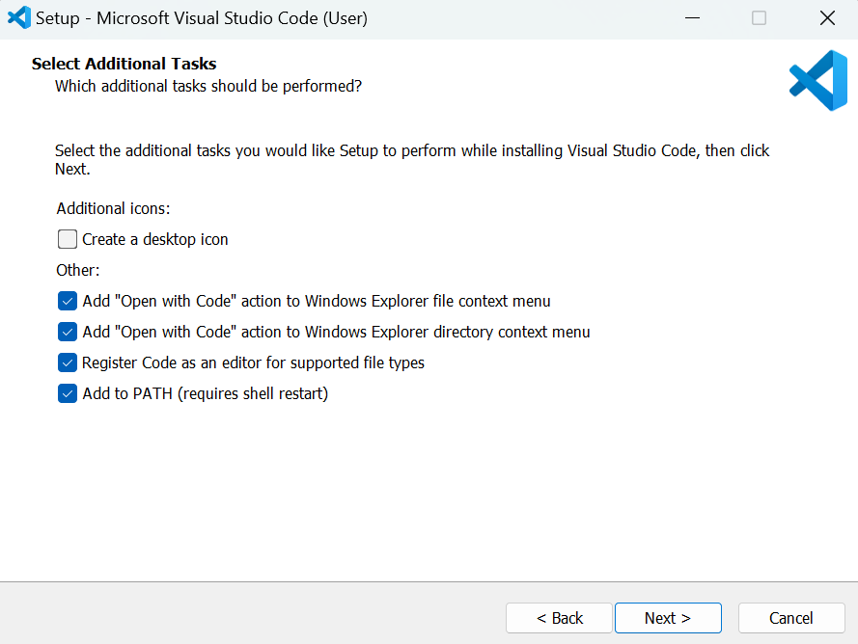
Install VS Code

Slide 7
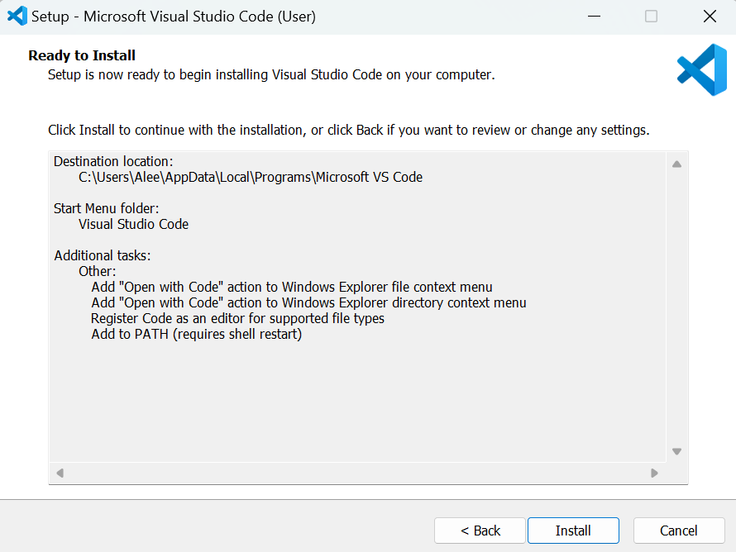
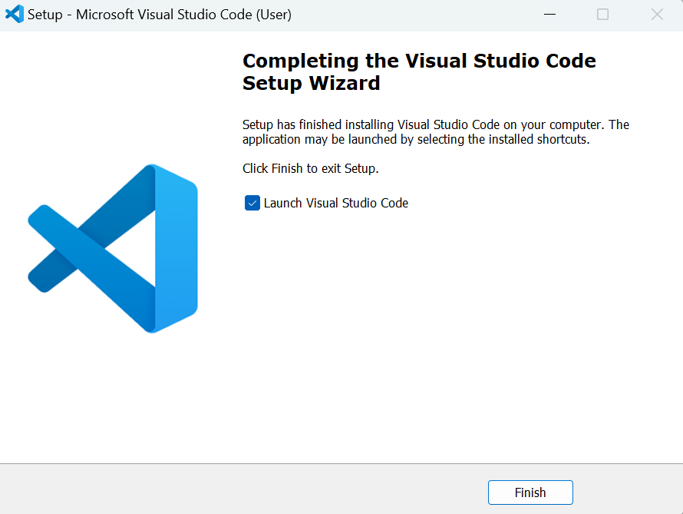
Install VS Code

Slide 8
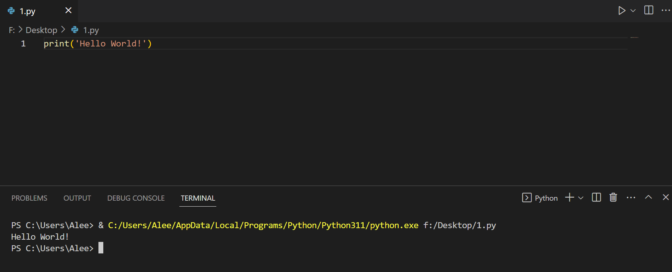
Open VS Code

Slide 9
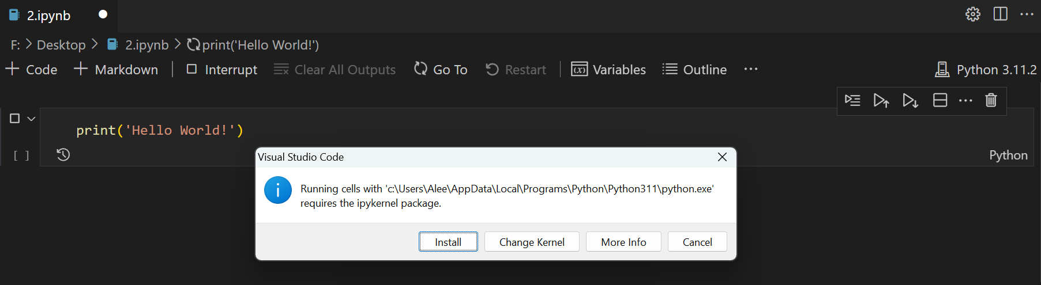
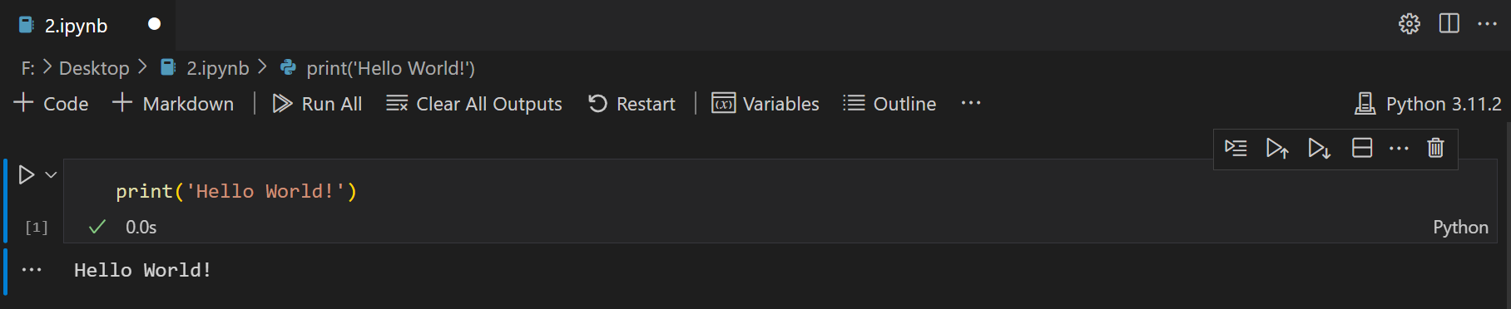
Jupyter Notebook

Slide 10
Thanks!
You can find me at:
github.com/AleeRezaa
t.me/Alee_Rezaa
alee_rezaa@outlook.com

